Slide 1
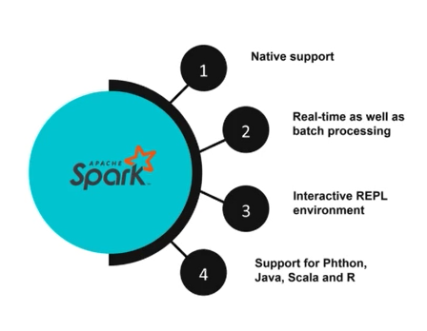
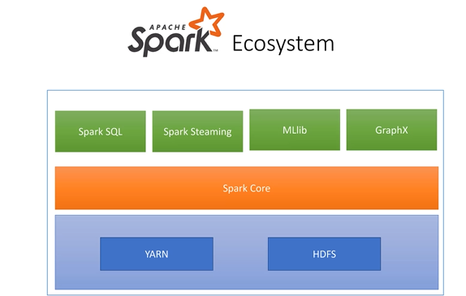

Slide 2
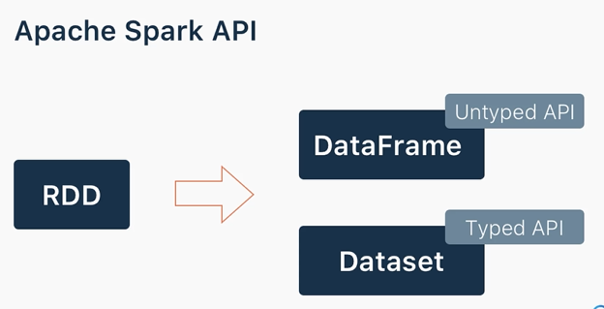

Slide 3
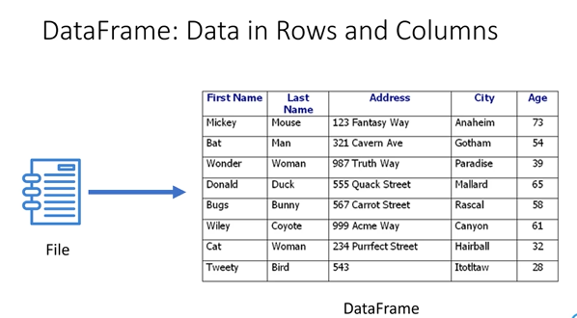
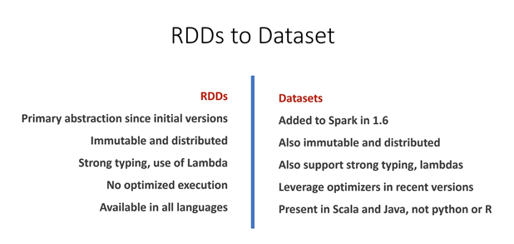

Slide 4
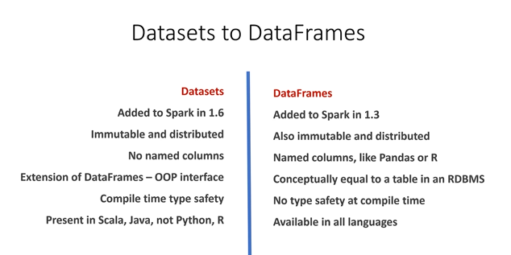

Slide 5

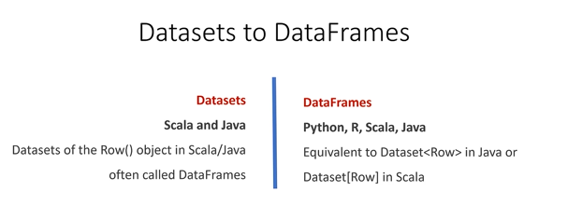

Slide 6
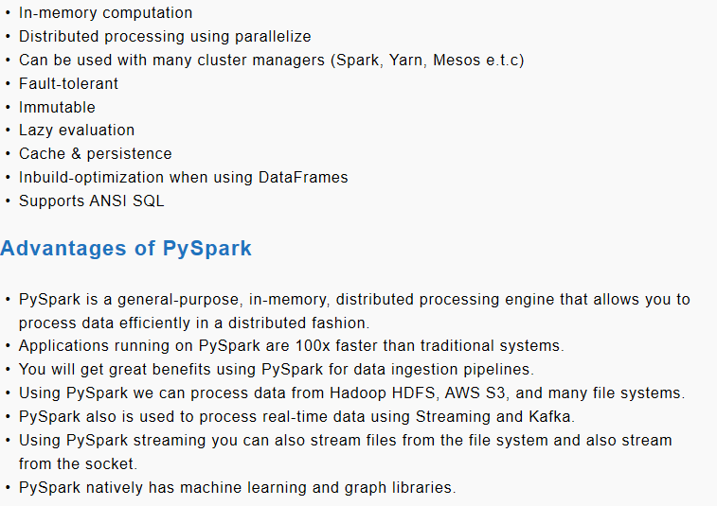
PySpark is a Spark library written in Python to run Python application using Apache Spark capabilities, using PySpark we can run applications parallelly on the distributed cluster (multiple nodes).
Features

Slide 7
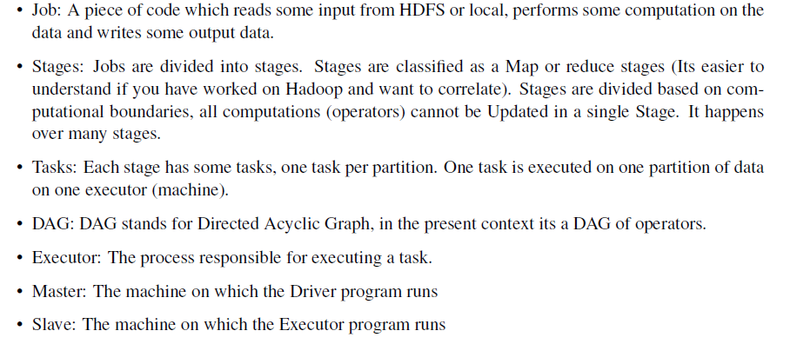
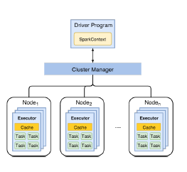

Slide 8
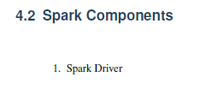
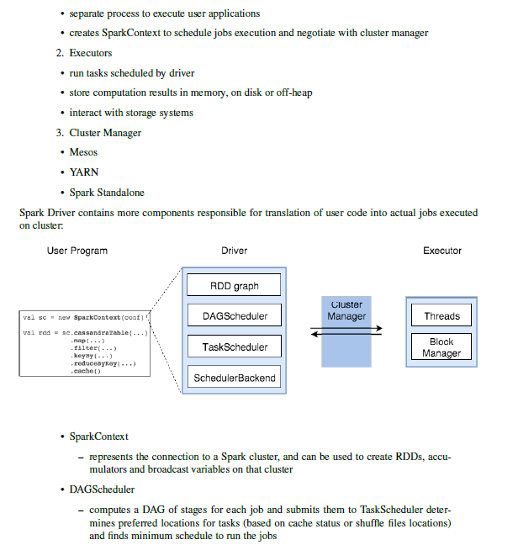
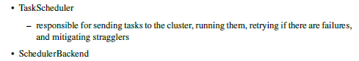
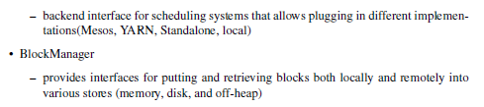

Slide 9
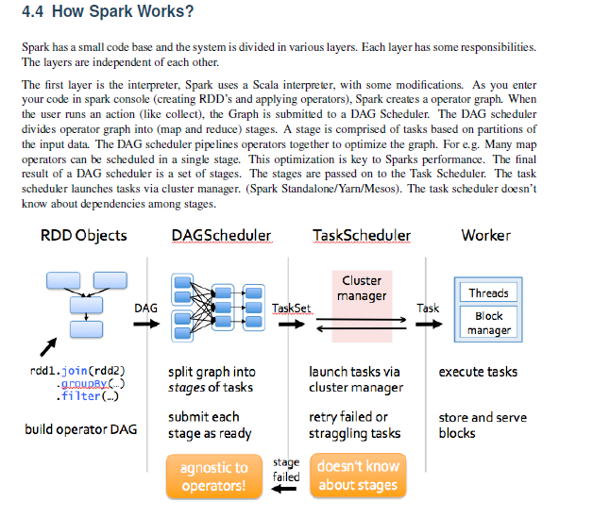

Slide 10
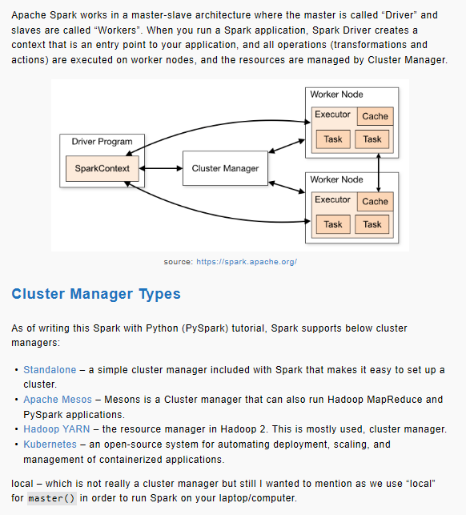
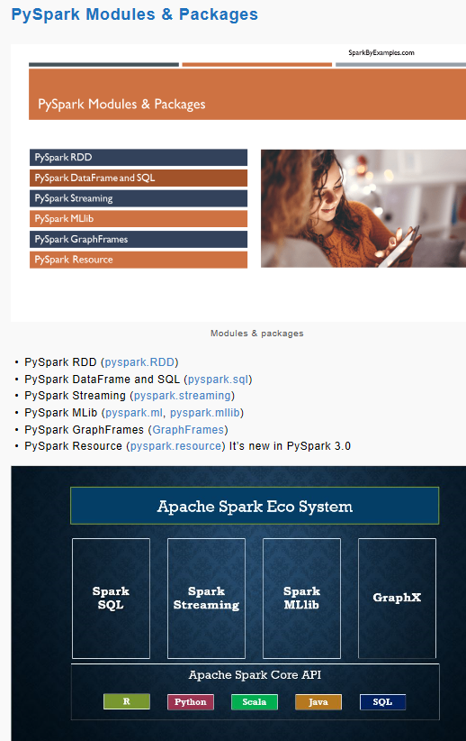

Slide 11
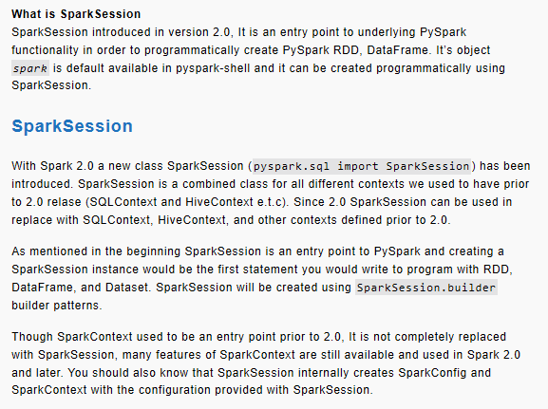
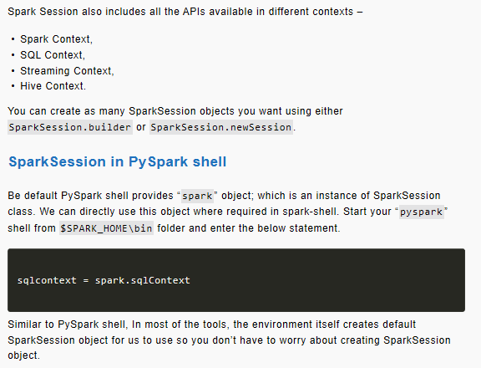

Slide 12
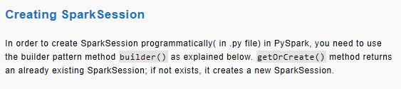
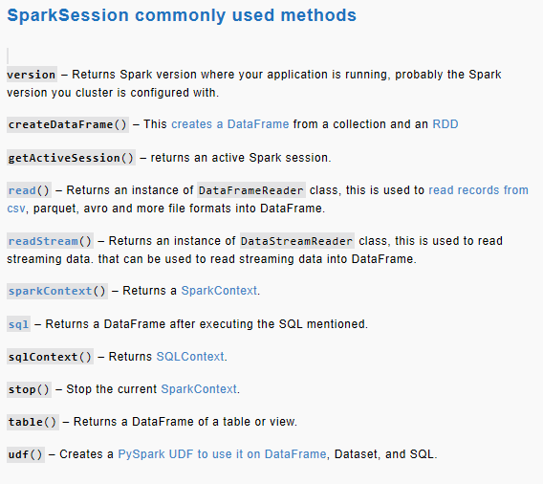
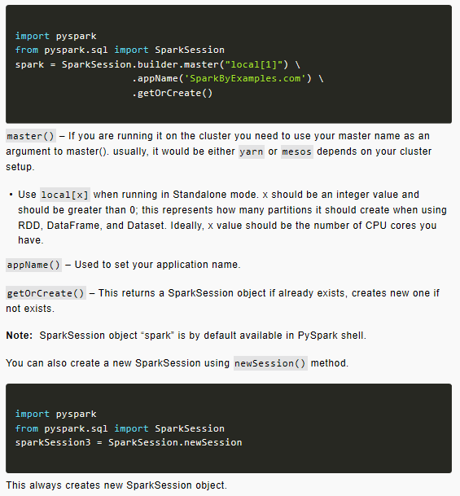

Slide 13
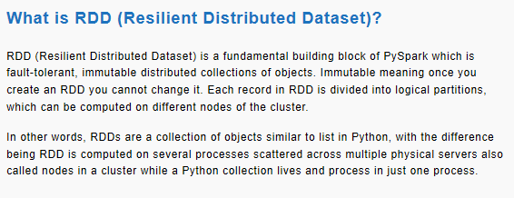
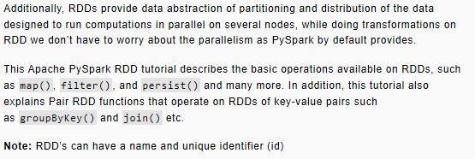

Slide 14
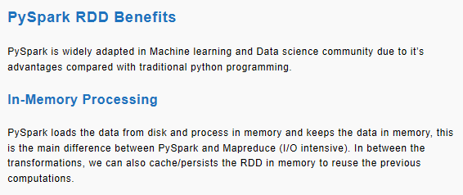
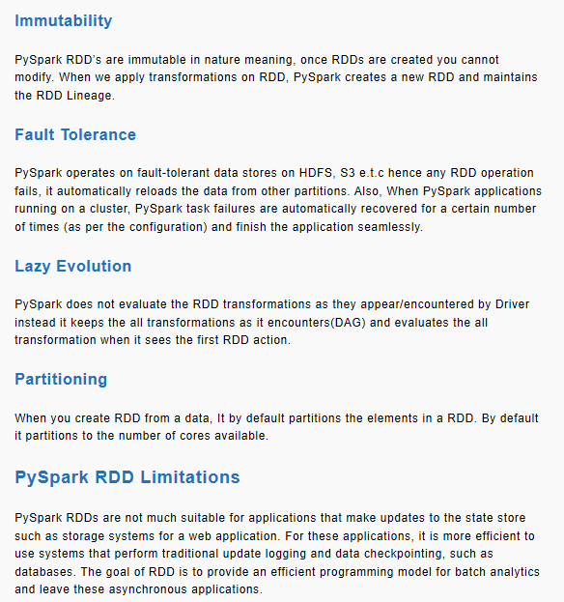

Slide 15
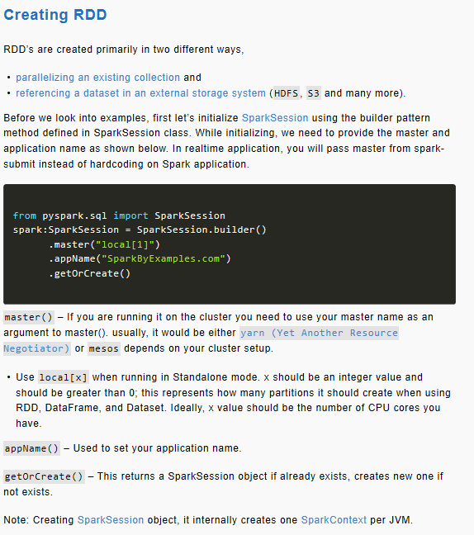

Slide 16
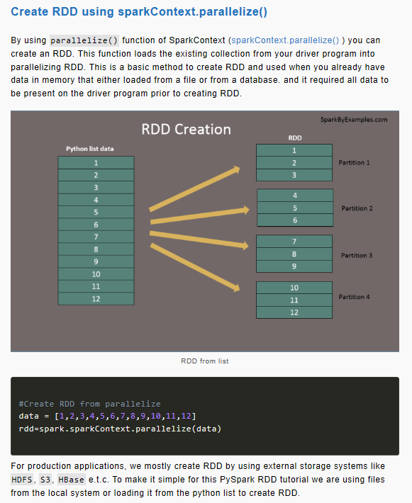
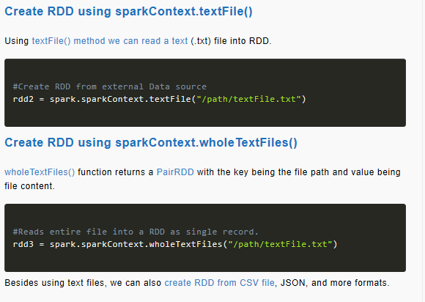

Slide 17
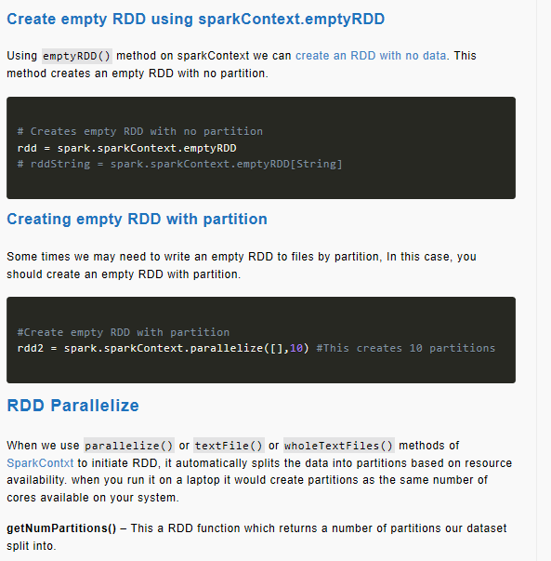
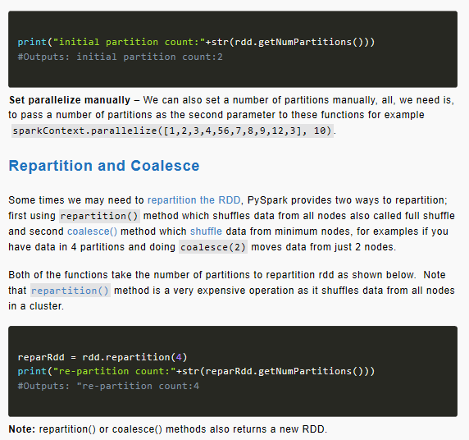

Slide 18
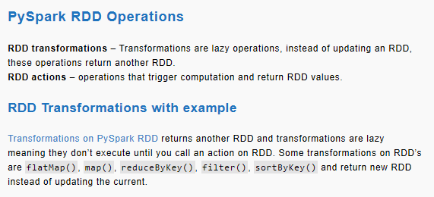
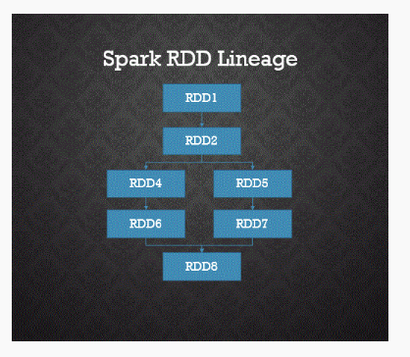

Slide 19
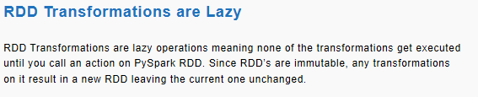
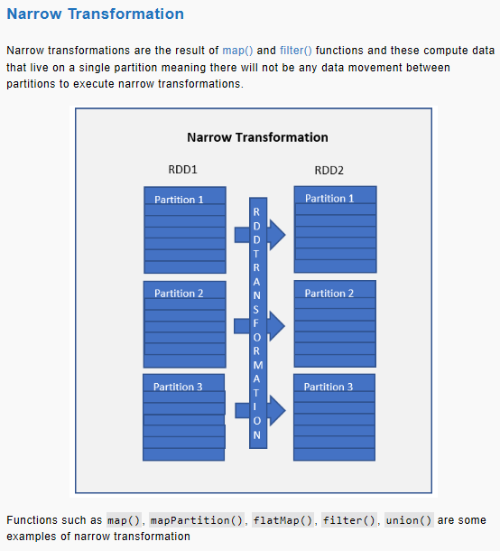
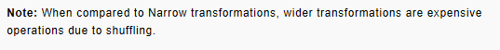
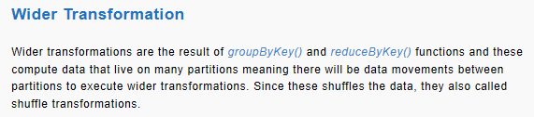
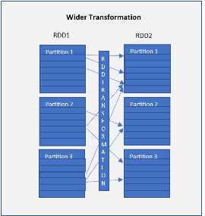
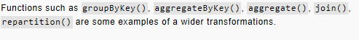

Slide 20
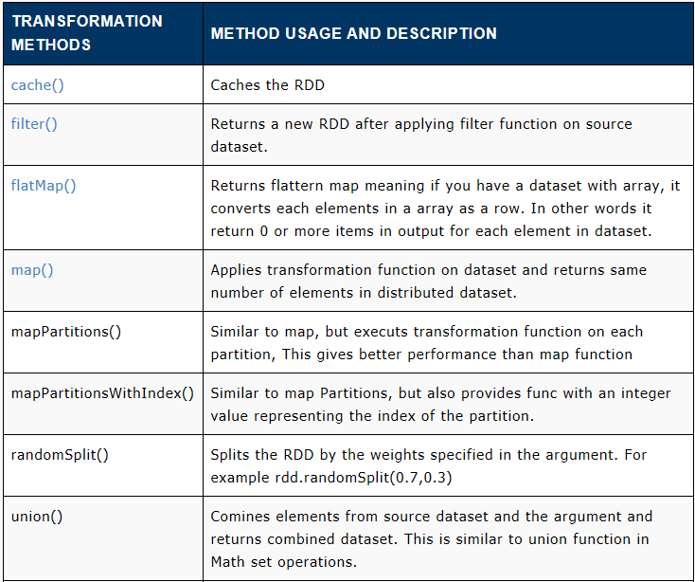

Slide 21
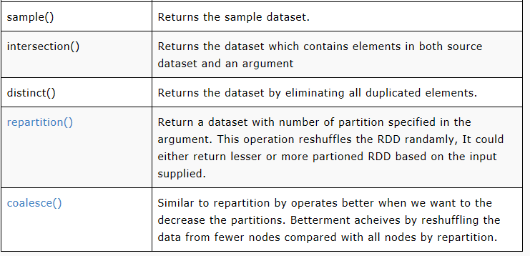

Slide 22
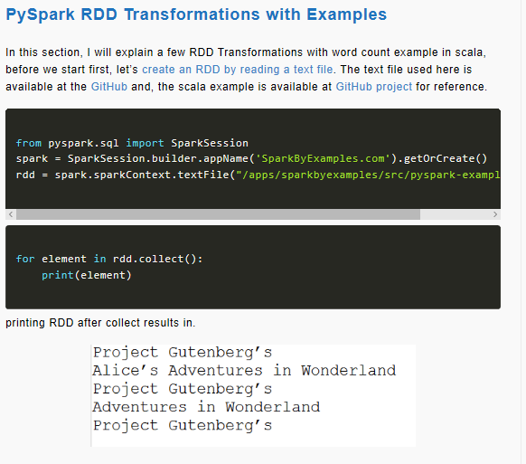
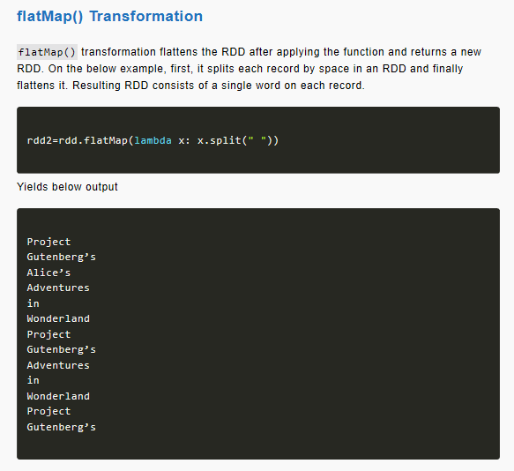

Slide 23
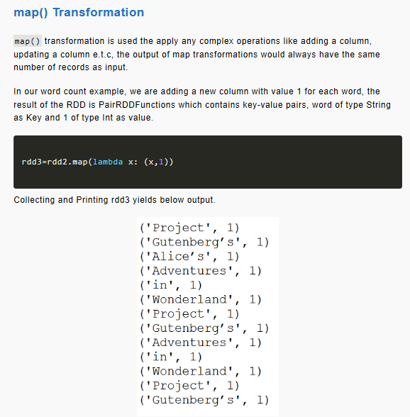
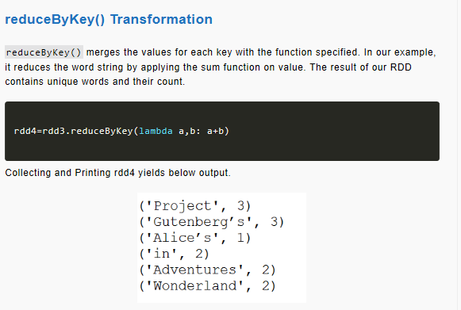

Slide 24
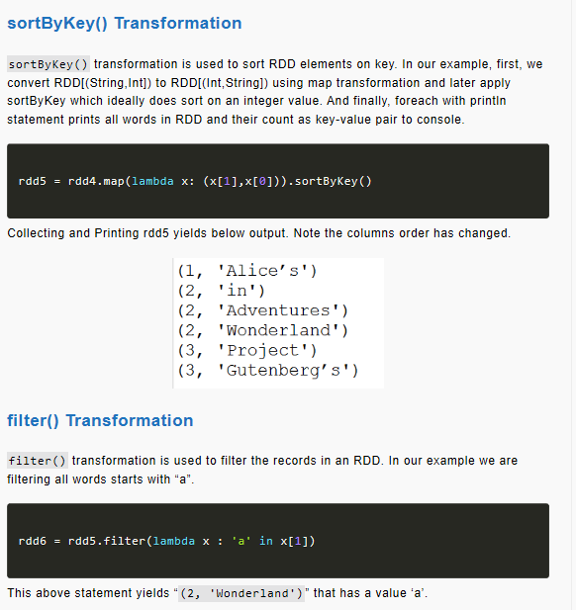
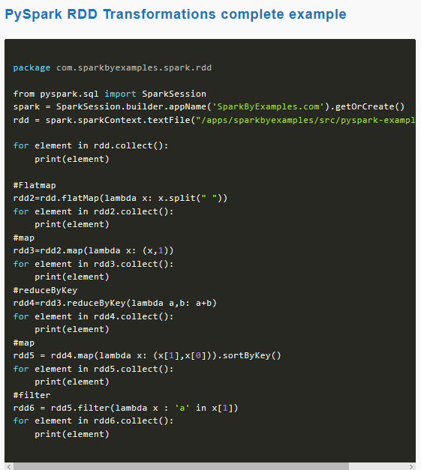

Slide 25
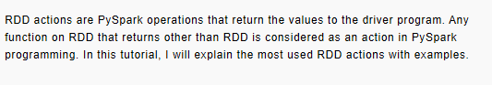
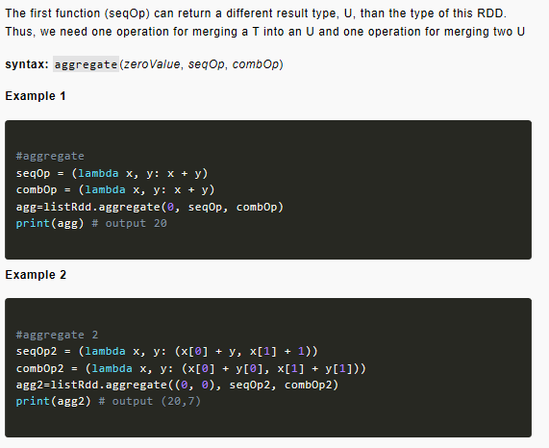
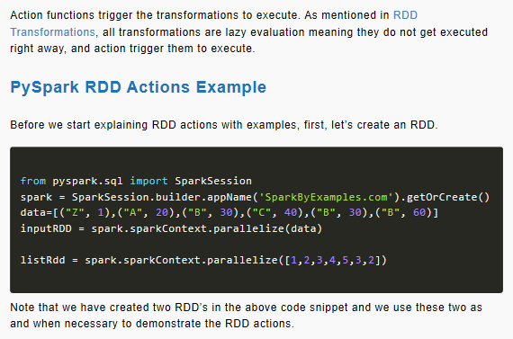


Slide 26




Slide 27



Slide 28




Slide 29




Slide 30


Slide 31



Slide 32





Slide 33



Slide 34



Slide 35


Slide 36



Slide 37







Slide 38


Slide 39



Slide 40



Slide 41



Slide 42



Slide 43



Slide 44



Slide 45




Slide 46



Slide 54


Slide 55


Slide 56


Slide 57


Slide 58



Data Lake Processing through Databricks
Without moving data from datalake we can do analysis and process the data in databricks in this demo first we will upload the file in the gen2 then we will authenticate databricks to datalake using azure service principal and mount data folder of data lake to databricks and then we will process the data and finally we will save the processed version of data back to datalake
Databricks file system is dbfs and you can mount datalake storage to dbfs. Mounting a file based storage to dbfs allows seemless access to data from the storage that means once you mount your datalake storage with the dbfs then you will be able to access the storage account from dbfs without any credentials and instead of using the URL’s now you can use file semantics as if they are local files. Using mounting point you can access the entire gen2 data
Azure datalake can be mounted using service principal, in simple terms we need to create a application identity with usrname and pswrd and databricks will use this identity to access database storage

Slide 59


Provision databricks and cluster on azure

Slide 60

Mount datalake to databricks DBFS
To create service principal go to active directory and register app there after creating from storage explorer go to gen account mange access and give access to the principal service that you created

Slide 61


Slide 62


Slide 63


Slide 64

Explore Analyze Clean and Transform

Slide 65





Slide 66


Slide 67
The extract, transform, load (ETL) process takes data from one or more sources, transforms it, normally by adding structure, and then loads it into a target database.
A common ETL job takes log files from a web server, parses out pertinent fields so it can be readily queried, and then loads it into a database.
ETL may seem simple: applying structure to data so it’s in a desired form. However, the complexity of ETL is in the details. Data Engineers building ETL pipelines must understand and apply the following concepts:
Optimizing data formats and connections
Determining the ideal schema
Handling corrupt records
Automating workloads

Slide 68
The Spark Approach
Spark offers a compute engine and connectors to virtually any data source. By leveraging easily scaled infrastructure and accessing data where it lives, Spark addresses the core needs of a big data application.
These principles comprise the Spark approach to ETL, providing a unified and scalable approach to big data pipelines:
Databricks and Spark offer a unified platform
Spark on Databricks combines ETL, stream processing, machine learning, and collaborative notebooks.
Data scientists, analysts, and engineers can write Spark code in Python, Scala, SQL, and R.
Spark's unified platform is scalable to petabytes of data and clusters of thousands of nodes.
The same code written on smaller data sets scales to large workloads, often with only small changes.
Spark on Databricks decouples data storage from the compute and query engine.
Spark's query engine connects to any number of data sources such as S3, Azure Blob Storage, Redshift, and Kafka.
This minimizes costs; a dedicated cluster does not need to be maintained and the compute cluster is easily updated to the latest version of Spark.

Slide 69


Slide 70

Databricks Delta
Databricks® Delta is a transactional storage layer designed specifically to harness the power of Apache Spark and Databricks DBFS. The core abstraction of Databricks Delta is an optimized Spark table that stores your data as Parquet files in DBFS and maintains a transaction log that efficiently tracks changes to the table.

Slide 71

The Solution: Databricks Delta
Databricks Delta is a unified data management system that brings reliability and performance (10-100x faster than Spark on Parquet) to cloud data lakes. Delta's core abstraction is a Spark table with built-in reliability and performance optimizations.
You can read and write data stored in Databricks Delta using the same familiar Apache Spark SQL batch and streaming APIs you use to work with Hive tables or DBFS directories. Databricks Delta provides the following functionality:
ACID transactions - Multiple writers can simultaneously modify a data set and see consistent views.
DELETES/UPDATES/UPSERTS - Writers can modify a data set without interfering with jobs reading the data set.
Automatic file management - Data access speeds up by organizing data into large files that can be read efficiently.
Statistics and data skipping - Reads are 10-100x faster when statistics are tracked about the data in each file, allowing Delta to avoid reading irrelevant information.

Slide 72



The %run command allows you to include another notebook within a notebook
%run "./Includes/Classroom-Setup-02"

Slide 73





Slide 74




Slide 75






Slide 76





Slide 77





Slide 78



Slide 79


Slide 80



Slide 81


Slide 82


Slide 83



Slide 84


Slide 85



Slide 86


Slide 87



Slide 88



Slide 89


Slide 90



Slide 91



Slide 92



Slide 93



Slide 94



Slide 95


Slide 96



Slide 97


